Slide 1
ATLIQ MEDIA — DATA PITCH DECK Tamil Nadu Decoded: The Election That Rewrote the Map A Data Story in Three Acts | 2026 Assembly Election Results Presented by Agila Govindan | Data Source: ECI 2026

Slide 2
ACT 0 — SETTING THE SCENE One Election. Three Numbers. A Story Tamil Nadu Has Never Seen Before. Source: Election Commission of India | 2021 & 2026 Tamil Nadu Assembly Election Results
234
163
108
Total Constituencies Across Tamil Nadu
Seats That Changed Hands in 2026
TVK Seats Won
In Their First Election

Slide 3
ACT 1 — THE FLIP STORY 7 Out of Every 10 Seats Changed Hands in 2026 163 of 234 constituencies flipped to a different party TVK won 102 of their 108 seats by flipping from other parties. Every TVK win in 2026 is automatically a flip — they did not exist in 2021. Source: ECI 2026 | Analysis based on constituency-level results
65 seats
DMK → TVK
26 seats
AIADMK → TVK
11 seats
INC → TVK

Slide 4
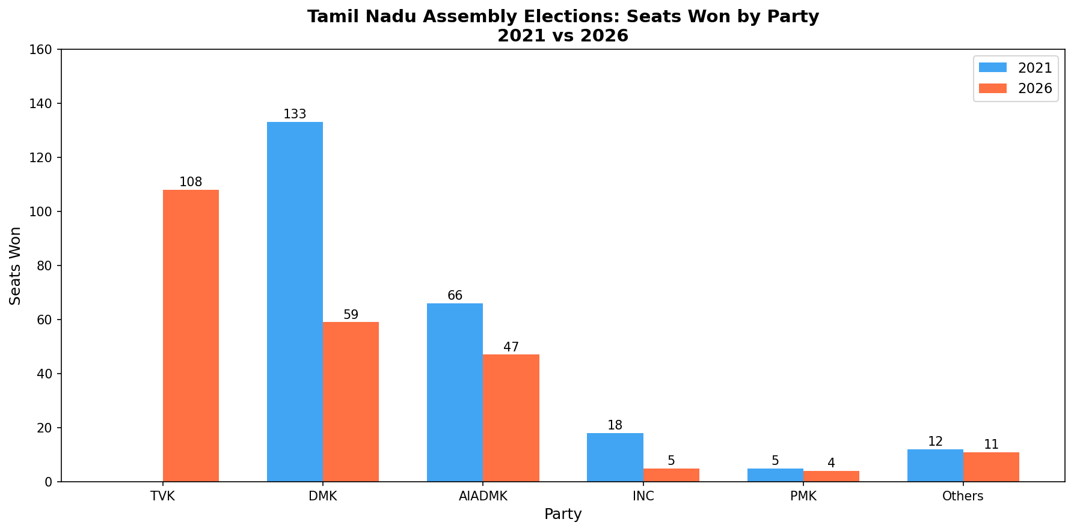
ACT 1 — THE FLIP STORY The Seat Count That Shocked Tamil Nadu Source: ECI 2021 & 2026 | chart shows seats won by major parties

Slide 5
ACT 2 — THE VOTE SHARE STORY TVK Captured 35% of All Votes In Their Very First Election While DMK lost 13.5% and AIADMK lost 12% of their vote share ★ Chennai Metro: DMK held 29 seats in 2021. TVK won exactly 29 seats in 2026. A complete handover. Source: ECI 2026 | Vote share calculated from total valid votes cast
34.92%
TVK Vote Share 2026
(was 0% in 2021)
24.19%
DMK Vote Share 2026
(was 37.7% in 2021)
21.21%
AIADMK Vote Share 2026
(was 33.29% in 2021)

Slide 6
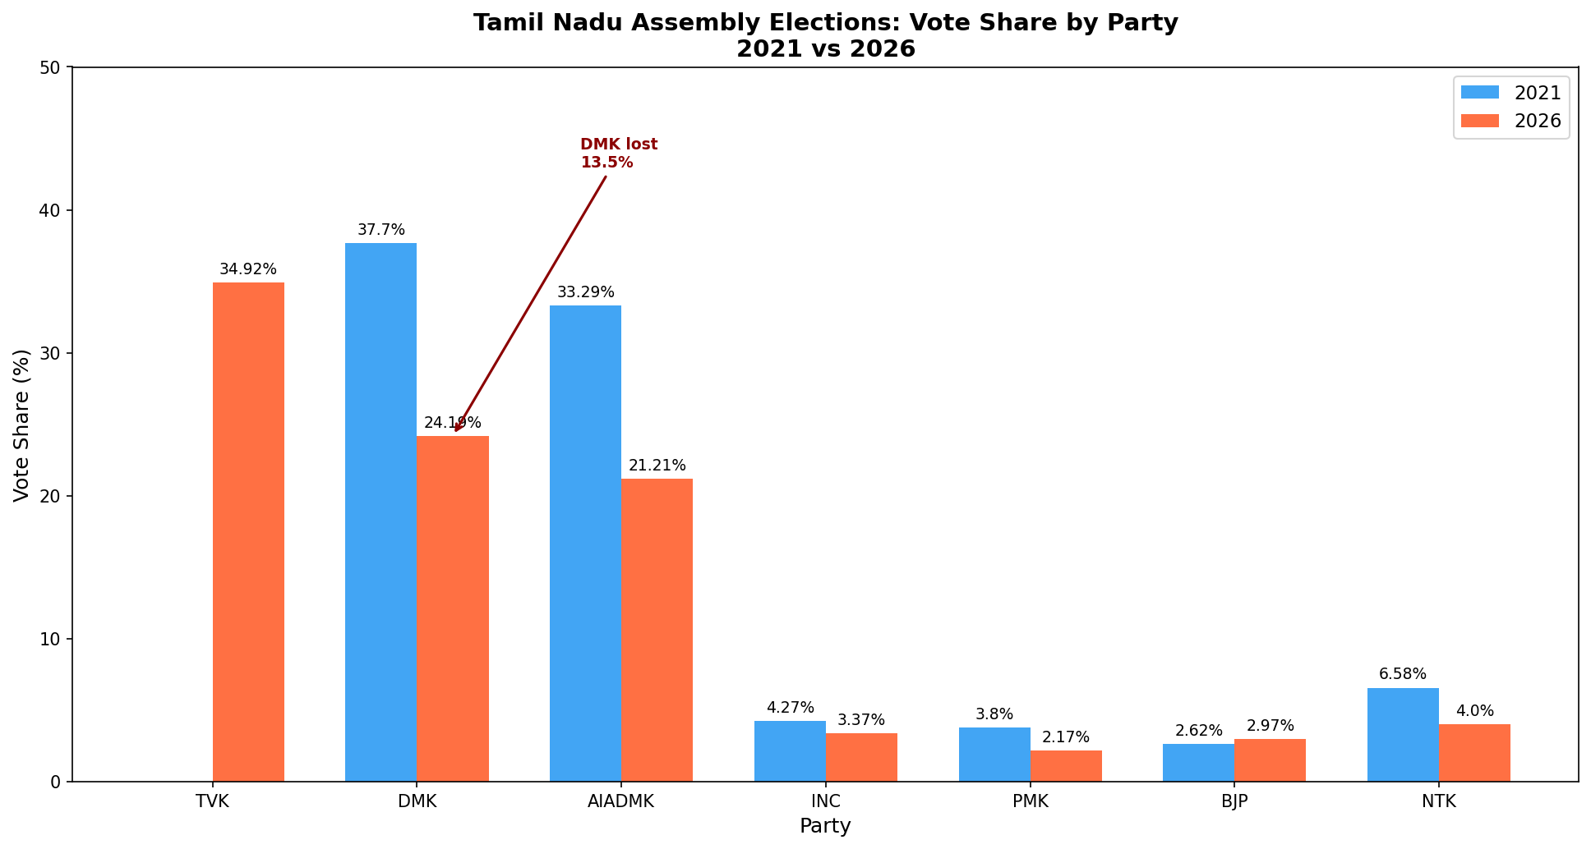
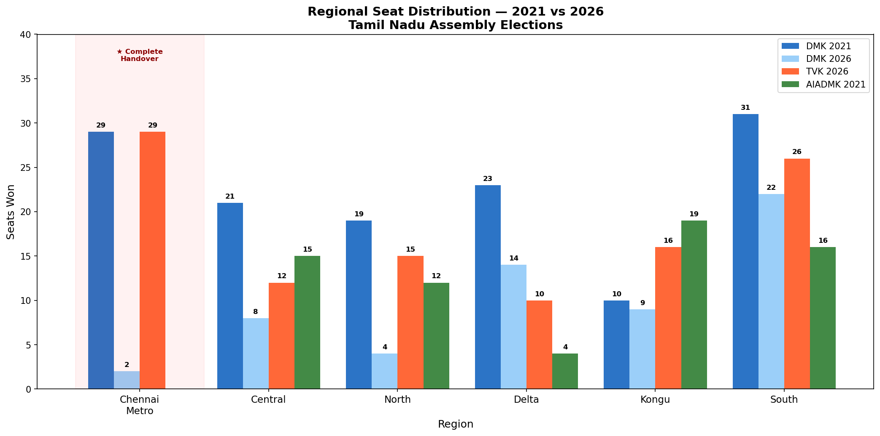
ACT 2 — THE VOTE SHARE STORY The Numbers Behind the Shift Source: ECI 2021 & 2026 | Regional breakdown across 6 zones of Tamil Nadu

Slide 7
ACT 3 — THE MARGIN STORY Most Winners Got Less Than 4 Out of Every 10 Votes Tamil Nadu 2026 was a three-way split — not a clean mandate In 64 constituencies, more than 65% of voters chose someone other than the winner. Source: ECI 2026 | Winner vote share = winner votes ÷ total votes per constituency
38.83%
Average winner
vote share
64 seats
Won with less
than 35% votes
Only 13 seats
Won with more
than 50% votes

Slide 8
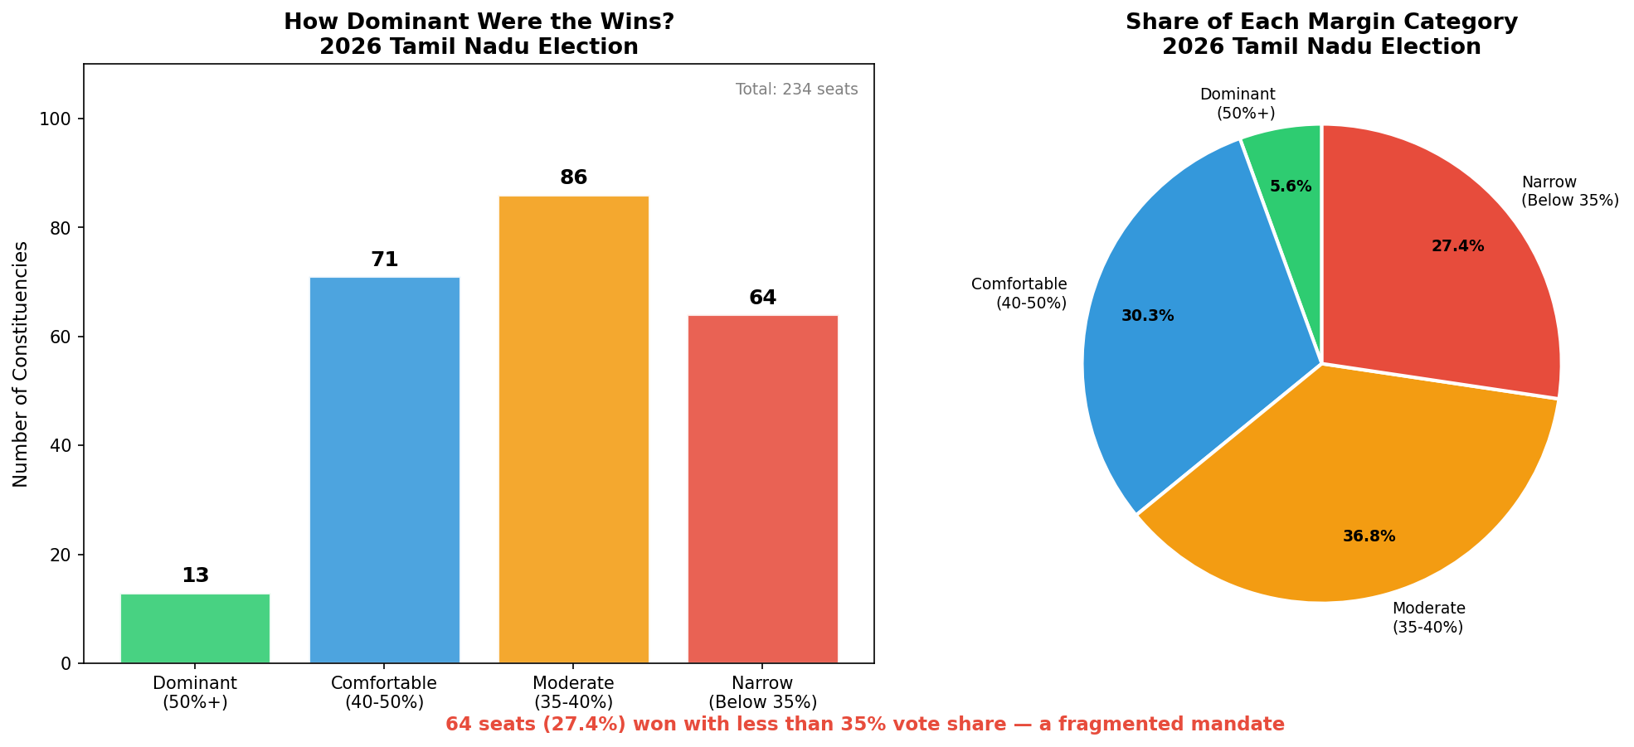
ACT 3 — THE MARGIN STORY How Dominant Were the Wins? Source: ECI 2026 | 234 constituencies analyzed | Winner vote share calculated from total valid votes

Slide 9
EDITORIAL RECOMMENDATION What AtliQ Media Should Cover In the One-Hour Show Remaining 10 minutes: Introduction + Data Disclaimer + Closing
01
THE FLIP SEGMENT
(15 minutes)
Show the 163 flips on screen.
Focus on Chennai Metro —
29 seats handed over completely.
Lead with the house flag analogy.
02
THE VOTE SHARE SEGMENT
(20 minutes)
Show party-wise vote share
shift from 2021 to 2026.
Highlight TVK's 35% in
their debut election.
03
THE MANDATE SEGMENT (15 minutes) Show margin categories. Explain that 64 seats were won with less than 35% — a fragmented, three-way Tamil Nadu.

Slide 10
DATA LIMITATIONS & SOURCES What This Data Cannot Tell Us Honest boundaries of this analysis Data Source: Election Commission of India | eci.gov.in | 2021 & 2026 Tamil Nadu Assembly Election Results
⚠ No Voter Demographics
This data does not tell us age,
gender, caste, or income of voters.
We cannot say who voted for whom.
⚠ No Turnout Data
2026 turnout figures were not
available in the ECI dataset used.
Turnout comparison not included.
⚠ No Exit Poll Data
We cannot explain why parties
won or lost. Only what the
numbers show — not the reasons.
⚠ Candidate-Level Only
Alliance-level seat sharing
arrangements are not reflected
in this constituency analysis..

